Slide 1
Chapter 2: Intelligent Agents
30 September 2020
1

Slide 2

Intelligent Agents
Agent is something that acts.
An Intelligent Agent perceives it environment via sensors and acts rationally upon that environment with its effectors (actuators).
An agent gets percepts one at a time, and maps this percept sequence to actions.
Properties of the agent
Autonomous
Interacts with other agents plus the environment
Reactive to the environment
Pro-active (goal- directed)
30 September 2020
2

Slide 3
Intelligent Agents
For Humans
Sensors: Eyes, ears , skin, tongue , nose, neuromuscular system
Percepts:
At the lowest level – electrical signals from these sensors
After preprocessing – objects in the visual field (location, textures, colors, …), auditory streams (pitch, loudness, direction), …
Effectors: limbs, eyes, tongue, etc…..
Actions: lift a finger, turn left, walk, run, carry an object, …
30 September 2020
3

Slide 4
Intelligent Agents
For Automated taxi driving system
Percepts: Video, sonar (for sound navigation), speedometer, odometer (distance), engine sensors, keyboard input, microphone, GPS (Global Positioning System), …
Actions: Steer, accelerate, brake, horn, speak/display, …
Goals: Maintain safety, reach destination, maximize profits (fuel, tire wear), obey laws, provide passenger comfort, …
Environment: Urban streets, freeways, traffic, pedestrians, weather, customers, …
30 September 2020
4

Slide 5
Intelligent Agents
The vacuum-cleaner world: Example of Agent
Environment: square A and B
Percepts: [location and content] E.g. [A, Dirty]
Actions: left, right, suck, and no-op
Percept sequence to Action
Percept sequence | Action
[A,Clean] | Right
[A, Dirty] | Suck
[B, Clean] | Left
[B, Dirty] | Suck
………. | ……
30 September 2020
5

Slide 6
Agent Function
Percept: The Agents perceptual inputs at any given instant.
Percept Sequence: The complete history of everything the agent has ever perceived.
The agent function is mathematical concept that maps percept sequence to actions.
f : P* --> A
The agent function will internally be represented by the agent program.
The agent program is concrete implementation of agent function it runs on the physical architecture to produce f.
30 September 2020
6

Slide 7
Rationality
Rational behavior: doing the right thing.
The right thing: that which is expected to maximize goal achievement, given the available information.
Rational Agent is one that acts so as to achieve the best outcome or, when there is uncertainty, the best expected outcome.
A rational agent chooses whichever action maximizes the expected value of the performance measure given the percept sequence to date and prior environment knowledge.
30 September 2020
7

Slide 8
Rationality
It is better to design Performance measure according to what is wanted in the environment instead of how the agents should behave.
It is not easy task to choose the performance measure of an agent.
For example
if the performance measure for automated vacuum cleaner is “The amount of dirt cleaned within a certain time”
Then a rational agent can maximize this performance by cleaning up the dirt , then dumping it all on the floor, then cleaning it up again , and so on.
Therefore “How clean the floor is” is better choice for performance measure of vacuum cleaner.
30 September 2020
8

Slide 9
Structure of Agents
An intelligent agent is a combination of Agent Program and Architecture.
Intelligent Agent = Agent Program + Architecture
Agent Program is a function that implements the agent mapping from percepts to actions.
Architecture is a computing device used to run the agent program.
30 September 2020
9

Slide 10
Characteristics of agents
Internal characteristics are
Learning/reasoning:
An agent has the ability to learn from previous experience and to successively adapt its own behavior to the environment.
Reactivity:
An agent must be capable of reacting appropriately to influences or information from its environment.
Autonomy:
There may need intervention from the user only for important decisions else operate automatically (independently).
Goal-oriented:
An agent has well-defined goals, gradually influence its environment so as to achieve its own goals.
30 September 2020
10

Slide 11
Characteristics of agents
External characteristics are
Communication:
An agent often requires an interaction with its environment to fulfill its tasks, such as human, other agents, and arbitrary information sources.
Cooperation:
Cooperation of several agents permits faster and better solutions for complex tasks that exceed the capabilities of a single agent.
Mobility:
An agent may navigate within electronic communication networks.
Character:
like human, an agent may demonstrate an external behavior with many human characters as possible.
30 September 2020
11

Slide 12
PAGE Descriptors of Agent
In designing intelligent systems there are four main factors to consider:
P Percepts – the inputs to our system
A Actions – the outputs of our system
G Goals – what the agent is expected to achieve
E Environment – what the agent is interacting with
PAGE Descriptors are not the only way of describing intelligent systems.
30 September 2020
12

Slide 13
PEAS Descriptors of Agent
To design a rational agent we must specify its task environment.
Task environment is defined and described by the PEAS description of the environment.
P Performance – how we measure the system’s achievements
E Environment – what the agent is interacting with
A Actuators – what produces the outputs of the system
S Sensors – what provides the inputs to the system
30 September 2020
13

Slide 14
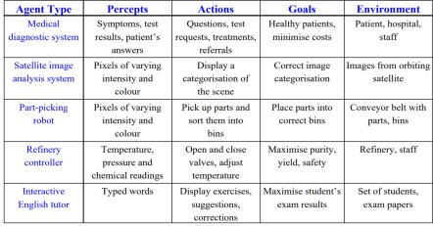

Agents and PAGE Descriptors
30 September 2020
14

Slide 15
Agent: Fully automated taxi
Performance: Safety, destination, profits, legality, comfort
Environment: Streets/freeways, other traffic, pedestrians, weather
Actuators: Steering, accelerating, brake, horn, speaker/display
Sensors: Video, sonar, speedometer, engine sensors, keyboard, GPS
30 September 2020
15

Slide 16
Agent: Medical diagnosis system
Performance measure: Healthy patient, minimize costs, lawsuits
Environment: Patient, hospital, staff
Actuators: Screen display (questions, tests, diagnoses, treatments, referrals)
Sensors: Keyboard (entry of symptoms, findings, patient's answers)
30 September 2020
16

Slide 17
Agent: Part-picking robot
Performance measure: Percentage of parts in correct bins
Environment: Conveyor belt with parts, bins
Actuators: Jointed arm and hand
Sensors: Camera, joint angle sensors
30 September 2020
17

Slide 18
Agent: Interactive English tutor
Performance measure: Maximize student's score on test
Environment: Set of students
Actuators: Screen display (exercises, suggestions, corrections)
Sensors: Keyboard
30 September 2020
18

Slide 19
Types of Agents
Simple Reflex Agents
Simple reflex agents ignore the rest of the percept history and act only on the basis of the current percept.
The agent function is based on the condition-action rule.
Problems with Simple reflex agents are :
Very limited intelligence.
No knowledge of non-perceptual parts of state.
Usually too big to generate and store.
If there occurs any change in the environment, then the collection of rules need to be updated.
30 September 2020
19

Slide 20
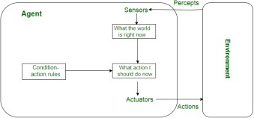
Simple Reflex Agents
30 September 2020
20

Slide 21
Types of Agents
Model-based reflex agents
A model-based agent can handle partially observable environments by use of model about the world.
The agent has to keep track of internal state which is adjusted by each percept and that depends on the percept history.
Updating the state requires information about :
how the world evolves in-dependently from the agent, and
how the agent actions affects the world.
30 September 2020
21

Slide 22
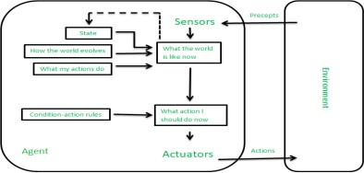
Model-based reflex agents
30 September 2020
22

Slide 23
Types of Agents
Goal Based Agents
These kind of agents take decision based on how far they are currently from their goal(description of desirable situations).
Their every action is intended to reduce its distance from the goal.
This allows the agent a way to choose among multiple possibilities, selecting the one which reaches a goal state.
30 September 2020
23

Slide 24
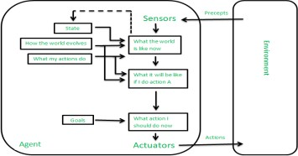
Goal Based Agents
30 September 2020
24

Slide 25
Types of Agents
Utility-based agents
When there are multiple possible alternatives, then to decide which one is best, utility-based agents are used.
They choose actions based on a preference (utility) for each state.
Utility describes how “happy” the agent is.
Because of the uncertainty in the world, a utility agent chooses the action that maximizes the expected utility.
A utility function maps a state onto a real number which describes the associated degree of happiness.
30 September 2020
25

Slide 26
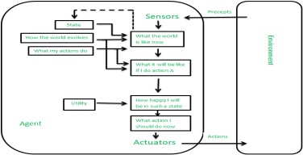
Utility-based agents
30 September 2020
26

Slide 27
The Agent Environments
Complete vs. Incomplete –
Complete AI environments are those on which, at any given time, we have enough information to complete a branch of the problem.
Chess is a classic example of a complete AI environment.
Poker, on the other hand, is an incomplete environments.
30 September 2020
27

Slide 28
The Agent Environments
Fully Observable vs. Partially Observable
A fully observable AI environment has access to all required information to complete target task.
Image recognition operates in fully observable domains.
Partially observable environments such as the ones encountered in self-driving vehicle scenarios deal with partial information in order to solve AI problems.
30 September 2020
28

Slide 29
The Agent Environments
Deterministic vs. Non-deterministic (stochastic) –
Deterministic AI environments are those on which the outcome can be determined based on a specific state. In other words, deterministic environments ignore uncertainty.
eg: vacuum world problem.
But most real world AI environments are not deterministic. Instead, they can be classified as stochastic.
Self-driving vehicles are a classic example of stochastic AI processes.
30 September 2020
29

Slide 30
The Agent Environments
Episodic vs. Non-episodic –
In an episodic environment the agent’s experience can be divided into “episodes” consisting of the agent perceiving and then producing actions that depend only on that episode.
Episodic environment: mail sorting system
Non-episodic environment: chess game
30 September 2020
30

Slide 31
The Agent Environments
Discrete vs. Continuous –
A discrete environment has a limited/finite number of distinct, clearly defined percepts and actions.
Chess is also classified as a discrete AI problem.
Continuous AI environments rely on unknown and rapidly changing data sources.
Vision systems in drones or self-driving cars operate on continuous AI environments.
30 September 2020
31

Slide 32
The Agent Environments
Competitive vs. Collaborative
Competitive AI environments face AI agents against each other in order to optimize a specific outcome.
Games such as GO or Chess are examples of competitive AI environments.
Collaborative AI environments rely on the cooperation between multiple AI agents.
Self-driving vehicles or cooperating to avoid collisions or smart home sensors interactions are examples of collaborative AI environments.
30 September 2020
32

Slide 33
The Agent Environments
Static vs. Dynamic –
Static AI environments rely on data-knowledge sources that don’t change frequently over time.
Speech analysis is a problem that operates on static AI environments.
Dynamic AI environments such as the vision AI systems in drones deal with data sources that change quite frequently.
30 September 2020
33

Slide 34
Single agent vs, multiple agent –
When there is only one agent in a defined environment, the environment is called the single agent environment.
The agent acts and interacts only with its environment.
If there is more than one agent in the environment, it is called multiple agent environment.
The agents interact with each other and their environment.
30 September 2020
34

Slide 35
Components of an AI Agent
A means to infer properties of the world from its percepts.
Information about the way the world evolves.
Information about what will happen as a result of its possible actions.
Utility information indicating the desirability of possible world states and the actions that lead to them.
Goals that describe the classes of states whose achievement maximizes the agent’s utility.
A mapping from the above forms of knowledge to its actions.
An active learning system that will improve the agent’s ability to perform well.
30 September 2020
35

